Slide 1
MACHINE LEARNING MINI-PROJECT
Traffic Flow Prediction
in Urban Areas
Predicting congestion levels from road, day and time
UE24CS352A
Machine Learning
2026
TEAM MEMBERS
PRIYANKA B M — PES1UG24AM207
PRASHANT DEVENDRA NAIK — PES1UG24AM199
Reference methodology adapted from Huang & Zhou (2021)

Slide 2
Problem Statement & Objective
02
THE PROBLEM
INPUT → MODEL → OUTPUT
Urban traffic conditions change
with road, day and time.
ROAD
DAY
HOUR
↓
• Traffic congestion varies across different roads and time periods.
• A machine learning model can learn patterns from historical traffic observations.
MLP CLASSIFIER
↓
CONGESTION 0–4
OBJECTIVE
Predict congestion level 0–4 from road + day + hour.
5-class classification problem
Why this matters: road conditions and traffic patterns vary over time. The model learns these relationships from historical observations and maps them to one of five congestion classes.

Slide 3
Dataset & Data Collection
03
35
selected route queries
1,071
traffic records
1 week
collection period
5
congestion classes
RAW COLUMNS
DATA SOURCE & SCOPE
• way — road / route identifier
• distance(meters) — route distance
• duration(minutes) — travel time
• datetime_utc — traffic observation timestamp
Outscraper
New traffic data was collected for selected routes around Central Park, New York City, following the reference paper's general methodology.
Newly collected dataset — not the authors' original dataset.
Each observation links a route and timestamp with measured distance and duration, providing the information needed to derive speed and congestion.

Slide 4
Data Preprocessing & Feature Engineering
04
1
Timestamp
2
Time
3
Speed
4
Label
UTC → New York local time
day_of_week + hour
distance / duration
5 congestion levels
SPEED FEATURE
CONGESTION LABELLING
Speed (km/h) =
0 Very Low 1 Low
Distance (km) ÷ Time (hours)
2 Moderate 3 High
4 Very High
Calculated from raw distance and duration.
Quantile-based adaptation for this dataset.
Why preprocess? Time is converted to local time so day/hour represent the actual New York traffic period. Speed provides the basis for congestion labelling.
Why quantiles? The newly collected data has a different speed distribution, so observations are divided into five approximately equal groups.

Slide 5
Machine Learning Methodology
05
BASELINE
IMPROVED
1 hidden layer
10 neurons
Road + day one-hot encoded
Hour standardized
• Numerical road representation
• Feature scaling
• Logistic activation
• 80/20 stratified split
• Two hidden layers: 20 → 10 neurons
• Logistic activation
• LBFGS optimization
Recorded test accuracy:
56.74%
Test accuracy: 39.07%
Feature representation is the key improvement.
MLP theory: hidden neurons learn combinations of input features, while the output layer assigns the observation to a congestion class.
One-hot encoding is used because road and day are categorical variables; it avoids treating category IDs as ordered numerical values.

Slide 6
Training & Model Evaluation
06
TRAINING SETUP
WHAT THE RESULTS SHOW
• 80% training / 20% testing
• Stratified split preserves class proportions
• Baseline and improved MLP models evaluated on the same test split
• Evaluation metric: test-set classification accuracy
• Confusion matrix used to inspect class-wise predictions
Baseline
39.07% test accuracy
Improved
56.74% test accuracy
Improvement = 17.67 percentage points
Saved model: traffic_congestion_model.joblib
The test set is kept unseen during training, so accuracy measures how well the learned model generalizes to new observations.
A confusion matrix gives class-wise detail: diagonal cells are correct predictions, while off-diagonal cells show where classes are confused.

Slide 7
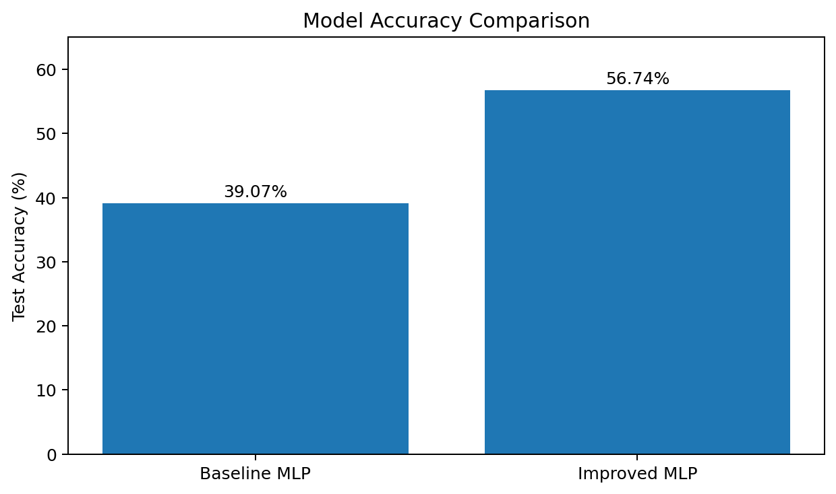
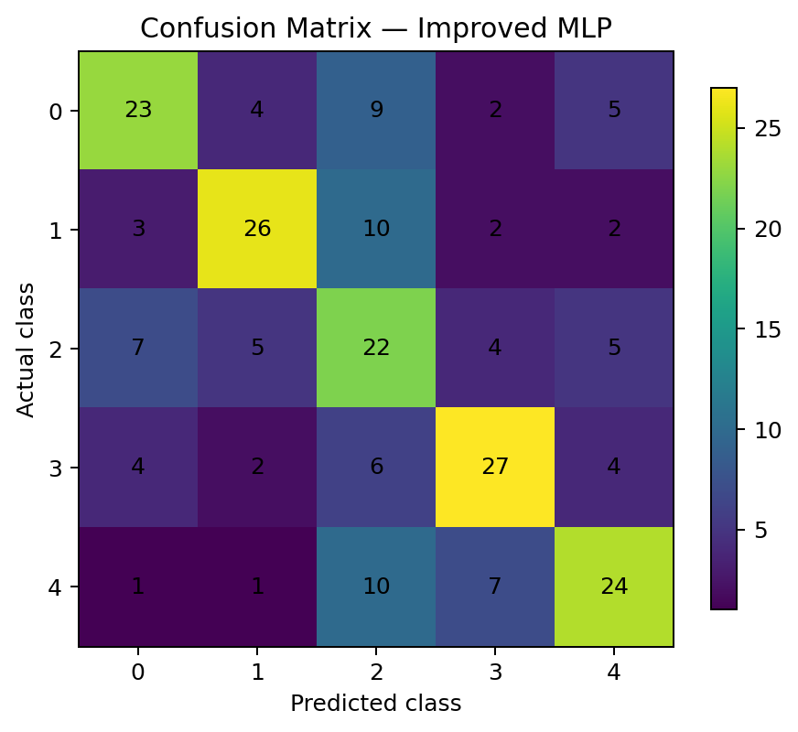
Results & Evaluation
07
ACCURACY COMPARISON
CONFUSION MATRIX — IMPROVED MODEL
Improvement: +17.67 percentage points
Diagonal cells represent correct classifications.
The improved model is 17.67 percentage points higher than the baseline.
The diagonal counts show correct predictions for congestion classes 0–4.

Slide 8
Live Demo, Limitations & Future Work
08
LIVE DEMO
LIMITATIONS
FUTURE WORK
Example input
• Smaller dataset than the reference study.
• Short collection period.
• Sampled observations rather than continuous monitoring.
• Quantile-based labels differ from the paper's original labelling approach.
• Collect more historical traffic data.
• Increase temporal coverage.
• Add richer traffic-related features.
• Explore sequence models such as LSTM.
Road: 5th Ave and 86th St Transverse
Day: Wednesday (2)
Hour: 14:00
Prediction
LEVEL 1 — LOW
The saved Joblib model is loaded by predict.py and produces the class from new inputs.
THANK YOU
Accuracy is not directly comparable to the paper's result.
Questions?
Demo logic: road + day + hour → saved MLP → predicted congestion class.
Reference: Huang, Y. & Zhou, G. (2021), Machine Learning for Traffic Flow Prediction in Urban Areas.

